Slide 1

Control of underactuated robots via input-constrained receding-horizon differential dynamic programming
Course of Underactuated Robots
Simone Orelli (mat. 1749732) Antonio Rapuano (mat. 2044902)
Dhaval Shukla (mat. 2047562)
Academic Year 2023/2024

Slide 2

Table of Contents 1 Introduction
Introduction
Differential dynamic programming
Optimal controller
Control of underactuated robots
Conclusion

Slide 3

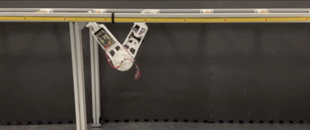
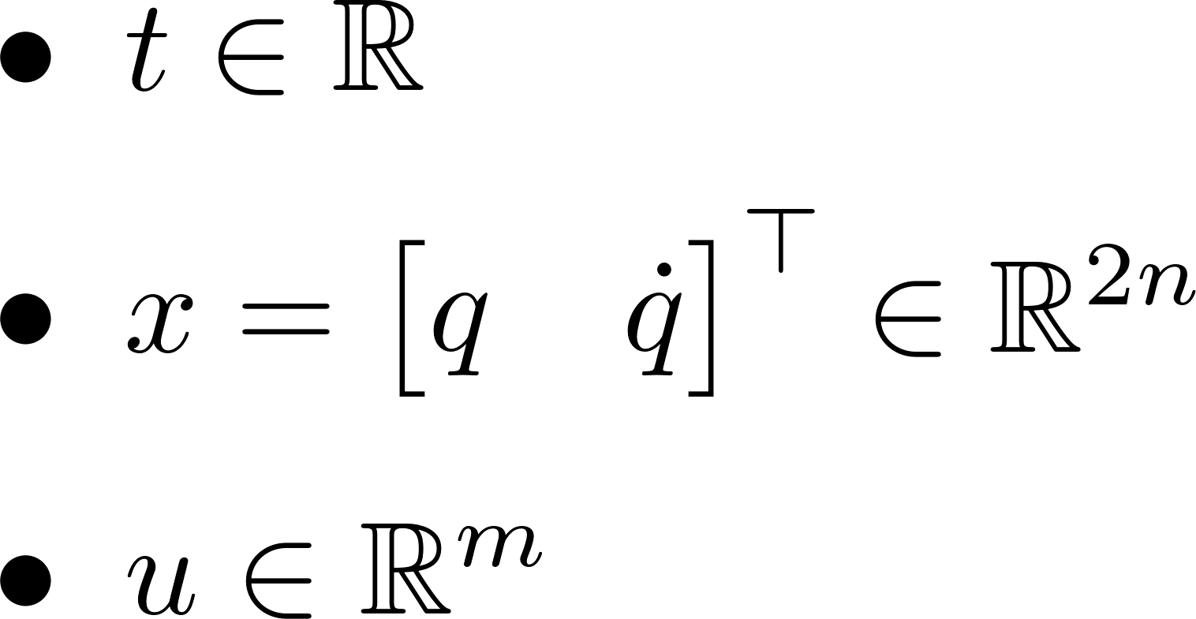
Underactuated robots 1 Introduction
Fully-actuated robots excel in precision and task execution, but when actuators are fewer than the degrees of freedom, a robot becomes underactuated, limiting its capabilities.
Underactuated robots, while more efficient and simpler in design, present significant control challenges, requiring advanced techniques to manage their complex dynamics.
time
state
Underactuation condition
input
drift vector field
control vector field
Notes:
UNDERACTUATION CONDITION: in general can happen at some (x, t), but usually we treat robots where underactuation is true for any (x, t).
Meaning: the control directly affects only a subset of the state-space. Only a number m (dim(u)) of directions can be controlled.

Slide 4
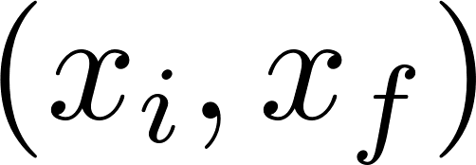
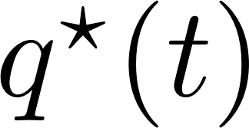
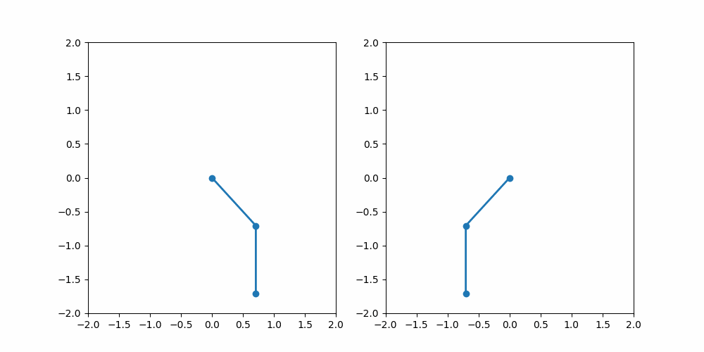
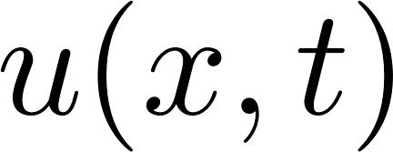
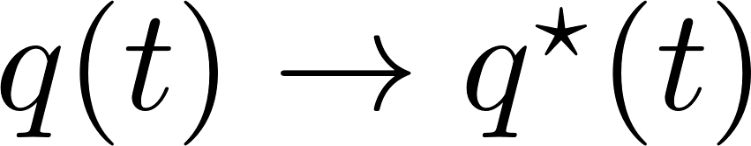
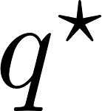
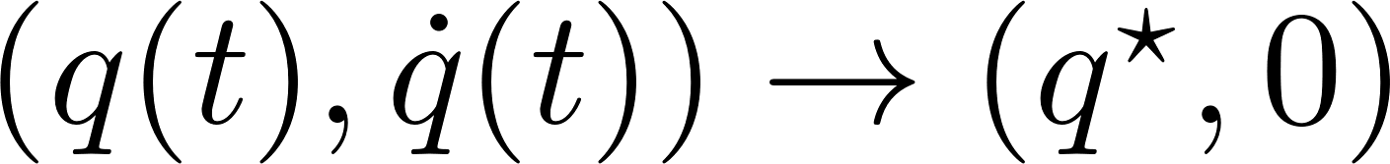
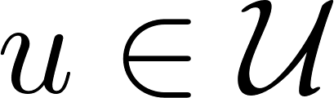
Objective 1 Introduction
P1
Trajectory planning:
Given
design a feasible ;
P2
Trajectory tracking:
Given design a feedback s.t. ;
P3
Setpoint regulation:
Given design a feedback s.t. ;
The pendubot and the acrobot should perform a swing-up motion satisfying hard constraints on the input torque.
Challenges
Hard input constraints
Exploitation of the natural dynamics
Input constraints (gen. torques/forces)
State constraints (gen. velocity/position)
Robustness
Pendubot
Acrobot
Notes:
When dealing with mechanical systems, we can solve three main control problems: P1, P2, P3. Since we’re working with UR, additional challenges that could arise are: […]
Precisely, we focus on the third problem P3: in particular, we look for a good trajectory that is able to bring the robot state to some desired reference configuration starting from an initial condition. The trajectory is implemented by designing a feedback control law. The control law design is further hindered by the presence of hard input constraints, which are introduced with the objective of describing the actual limitations of the robot actuators (lim. On velocity, torque etc) and must be satisfied strictly at all times.

Slide 5
Table of Contents 2 Differential dynamic programming
Introduction
Differential dynamic programming
Optimal controller
Control of underactuated robots
Conclusion
Notes:
A widely-used class of optimal control algorithms that allows good trajectory tracking performance in UR (which present a high-degree of nonlinearity) is that of DDP methods.
Here, we present a brief overview of the DDP algorithm.

Slide 6

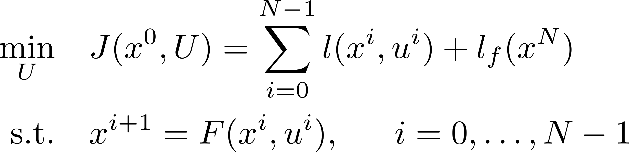
Optimal control problem 2 Differential dynamic programming
Discrete-time dynamics (e.g. via Euler’s forward method):
time step
Formulation of an optimal control problem:
cost function
running cost
terminal cost
control sequence
Notes:
The numerical implementation of the DDP algorithm is built on a time-discrete optimal control problem encoding both the system dynamics and the control objective. One possible way for discretizing the mathematical model of a UR is to use an integration method such as Euler’s FM. Given a control input, a state vector and a step time T, the discretized dynamics is […]. The cost function to minimize comes from the sum of the running cost and a terminal cost. Simple and common choices are quadratic forms. The optimal control sequence to feed to the system is the one that minimizes the cost function J according to the discretized system dynamics. Notice that the DDP algorithm alone does not allow to enforce a constraint on the final state, i.e. the terminal cost is crucial to guide the system toward the desired equilibrium.

Slide 7
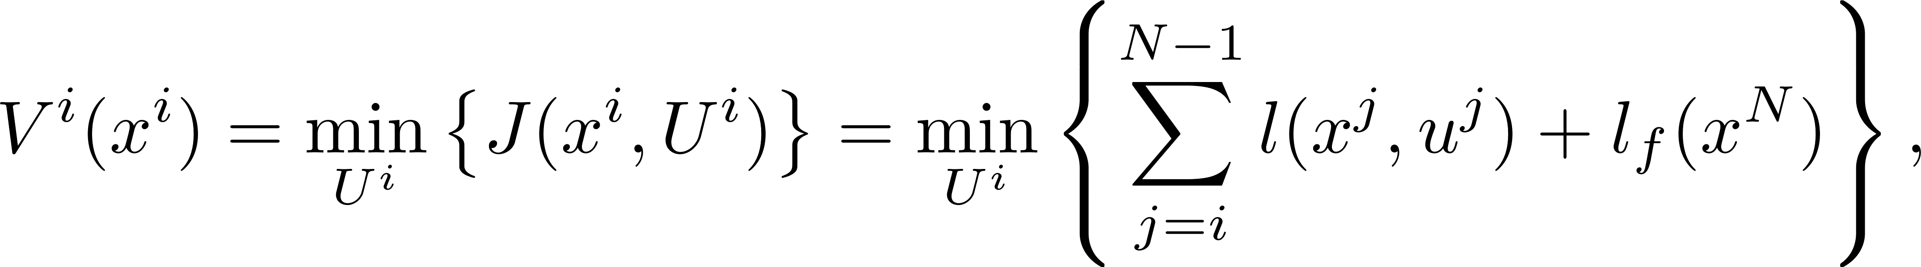
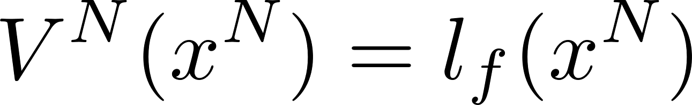
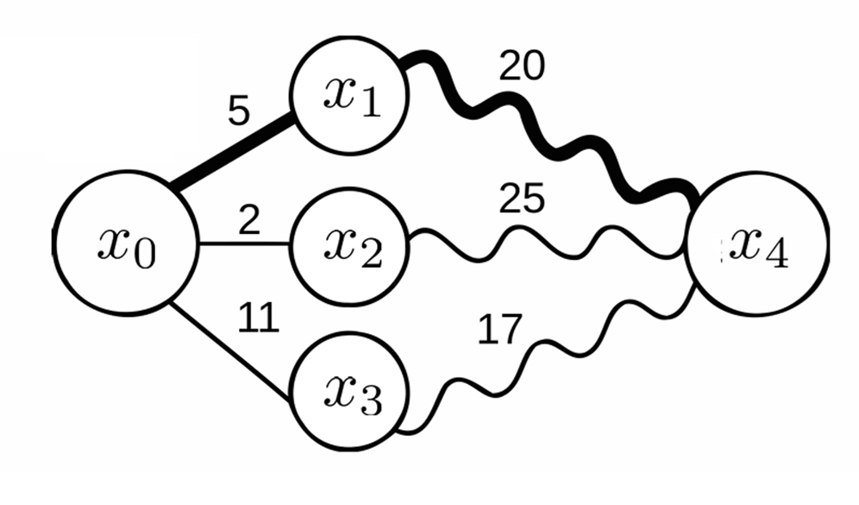
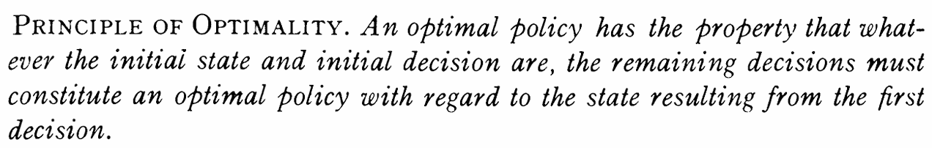
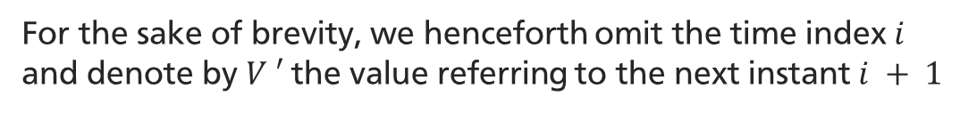
Local dynamic programming 2 Differential dynamic programming
Bellman’s principle
For the sake of brevity, we henceforth omit the time index $i$ and denote by $V ′$the value referring to the next instant $i + 1$
Notes:
The DDP alg plays around the so-called value function, defined as the minimum cost-to-go from time instant i until the end of the prediction horizon. According to BOP the value function can be rewritten recursively as […], with the Q-function being the argument of the minimization.

Slide 8
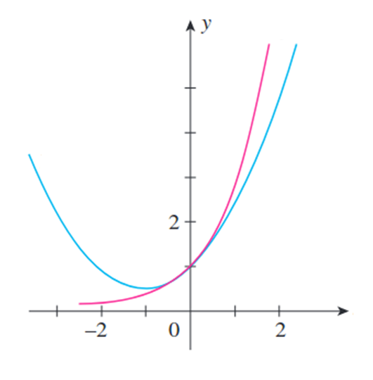
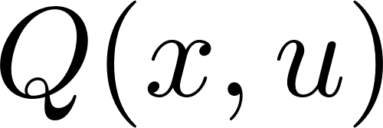
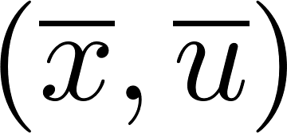

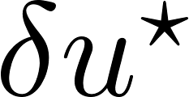
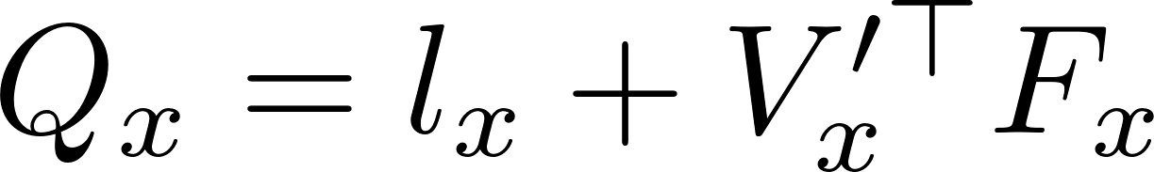
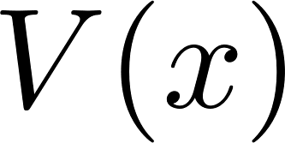
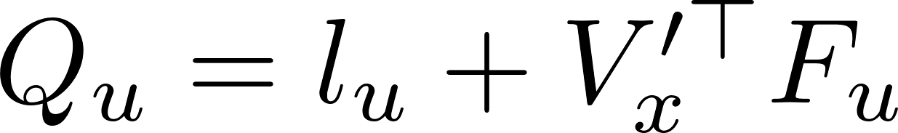
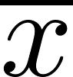
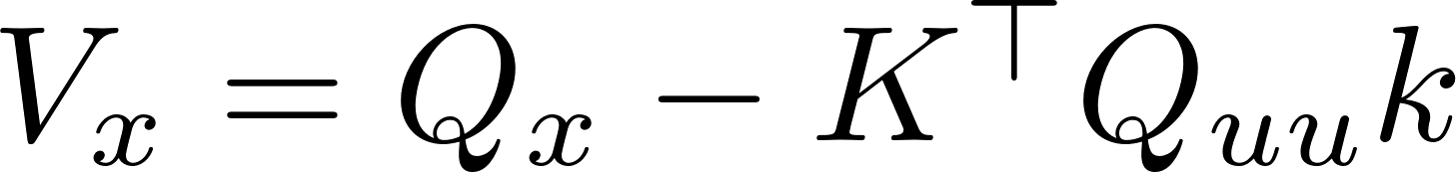
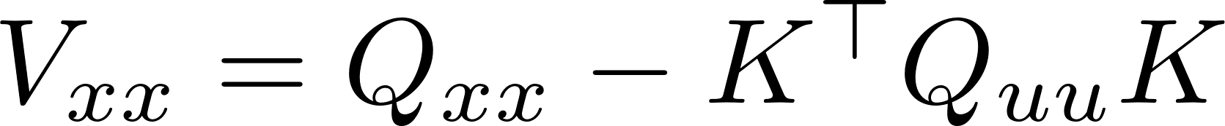
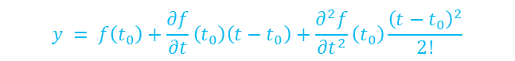

Quadratic approximation 2 Differential dynamic programming
$$y = f(t)$$
$$y = f\left(t_{0}\right)+\frac{∂f}{∂t}\left(t_{0}\right)\left(t−t_{0}\right)+\frac{∂^{2}f}{∂t^{2}}\left(t_{0}\right)\frac{{\left(t−t_{0}\right)}^{2}}{2!}$$
Taylor’s second order expansion around
We ought to find the control adjustment that minimizes the quadratic approximation of the Q-function.
Optimal
control
adjustment
Taylor’s second order expansion around
Notes:
The Q-function that we’ve just introduced can be expanded using Taylor’s second-order approximation around a nominal state-control pair, and the same can be done for the value function. The values of the hessians and the gradients are those in the right lower corner, and they have been extracted from the expansion. The optimal control adjustment with respect to a state deviation delta_x is obtained by minimizing the quadratic model of the Q-function with respect to delta_u, yielding a local state-affine policy delta_u_star.
Notice that the coefficients of the quadratic approximations are linked recursively: the coefficients of Q depend on the coefficients of V at the next time instant, while the coefficients of V depend on those of Q at the current time instant.

Slide 9
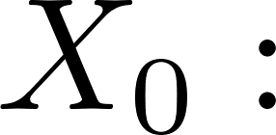
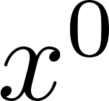
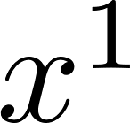
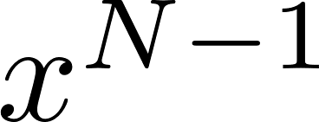
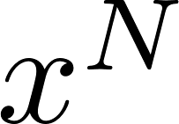
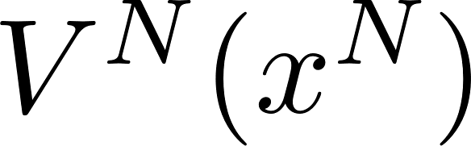
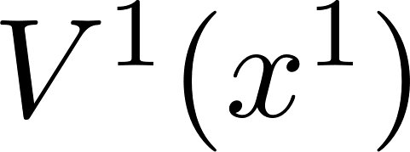
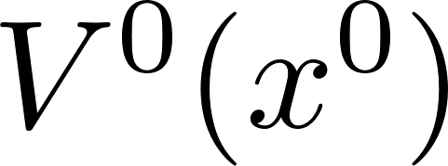
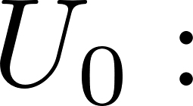
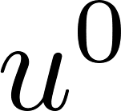
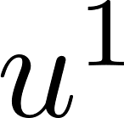
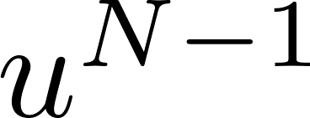

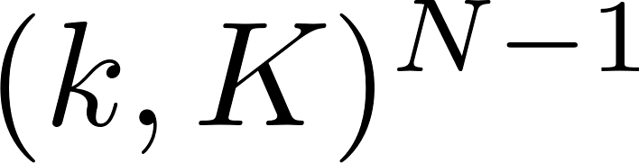
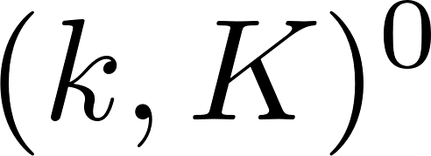
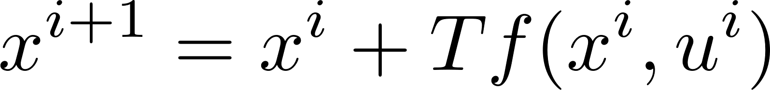
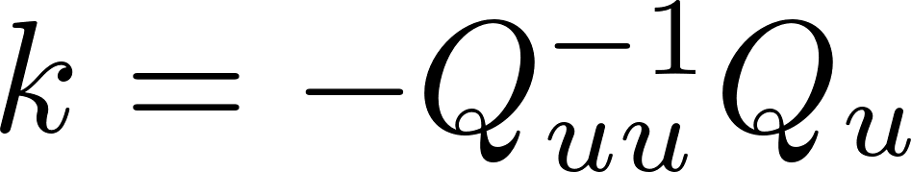

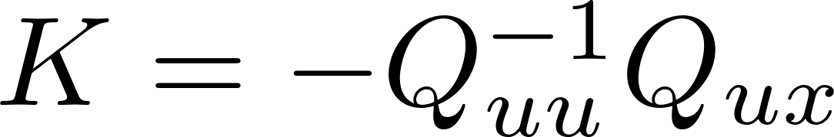
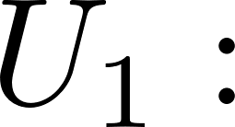



Backward and forward sweeps 2 Differential dynamic programming
Forward sweep $0$
A
Backward sweep $0$
B
Forward sweep $1$
C
A
B
C
Notes:
Our goal is to design an optimal control sequence to solve P3 by minimizing an adequately-built cost function.
So far we have seen how to translate this problem into a local one through the computation of the quadratic models of the Q and value functions. This translation allows us to compute a local closed-form solution of the optimization problem. Finding a global optimal solution is a non-trivial task that involves iterating in a gradient method fashion. The ground step consists in computing the state sequence X_0 that corresponds to an initial guess for the control sequence U_0 using the discretized system dynamics (A). Typically, U_0 is set to a stack of 0, and therefore X_0 is the system free evolution. Obtaining the value of the last state x^N of X_0 unlocks the ability of calculating the coefficients of the expansions of the Q and value functions, backward from the final to the initial state. These are used to put together the gains of the local state-affine policy, namely k and K, for each time instant of the horizon (B). Once we have the sequence of gains, we are able to find a «modified» control sequence that deviates from the nominal of the quantity delta_u_star (C). The newfound control sequence allows the computation of the next state sequence X_1, and hence it is possible to re-apply the same steps (seen just now) until a satisfactory solution is found.

Slide 10
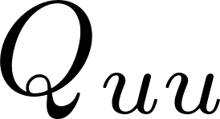
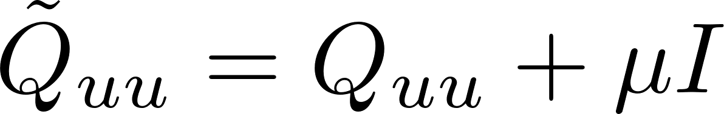
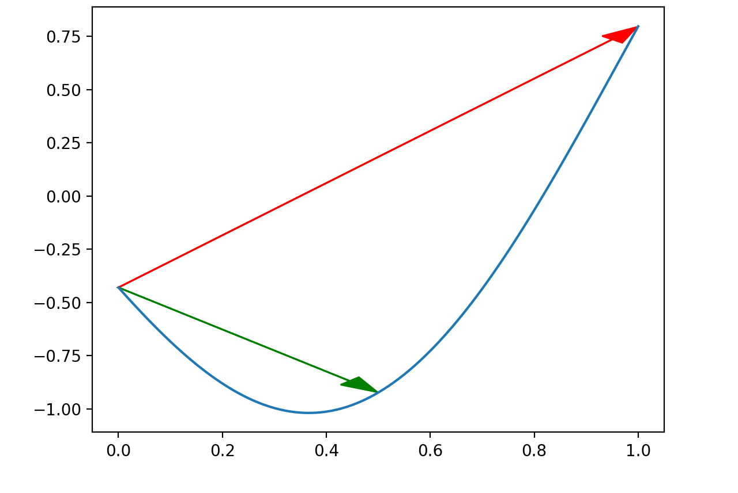


Regularization 2 Differential dynamic programming
R1
Levenberg-Marquardt parameter
Ensuring the positive-definiteness of the Hessian .
R2
Line search
To prevent divergence between the proposed trajectory and the previous one (resulting in substantial error in the quadratic approximation), we seek the optimal step size that minimizes the cost along the direction of the control adjustment.
the feedback term is unaffected
Notes:
In this slide we focus on common weaknesses of the DDP and how they can be addressed in the implementation phase. In order to guarantee the existence of a minimum we have to ensure that the hessian Q_uu is positive definite. To this end, a diagonal and small regularization term is added. At each forward sweep, the found trajectory could significantly diverge from the previous one, making a substantial error in the quadratic approximation. To prevent this, a line search is performed to find the optimal step size alpha that minimizes the cost along the direction of the control adjustment. Alpha is iteratively reduced until the cost of the proposed trajectory decreases sufficiently. If alpha becomes too small, the optimal control has been found.

Slide 11
Table of Contents 3 Optimal controller
Introduction
Differential dynamic programming
Optimal controller
Control of underactuated robots
Conclusion
Notes:
The aim of this section is to design an optimal control law that exploits the DDP algorithm in such a way that a NLS is led to an objective optimally with respect to some cost.

Slide 12
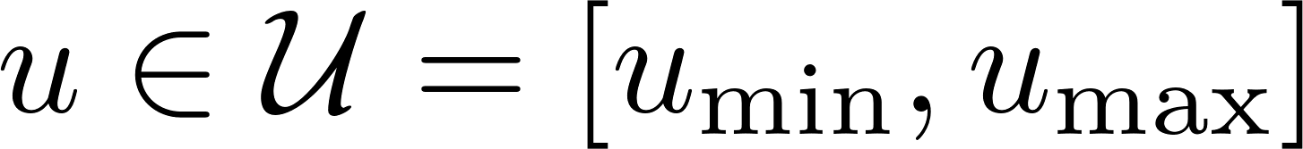
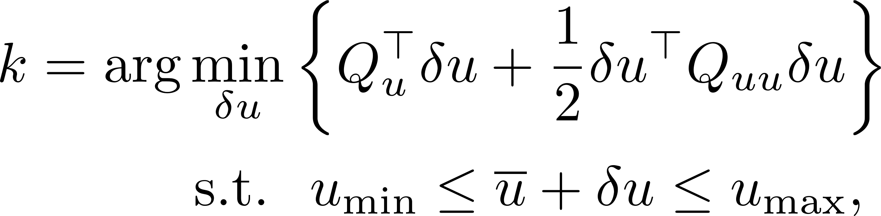



Hard input constraints 3 Optimal controller
Box constraint:
C1
Naive clamping
Clamping the control input in the forward sweep
C2
Squashing function
Using a sigmoidal squashing function on the control input in the forward sweep
C3
Constrained quadratic programming
Solving a constrained QP problem in order to take into account the control limitations
the rows of $K$ corresponding to clamped controls are identically zero
Notes:
Often, the actuators of a robot are subject to physical limits. In particular in the case of revolute joints the torque is bounded by the motor capacity. These kinds of limitations are typically accounted for by introducing box constraints. Here, we propose three alternatives to handle box constraints. C1 naive clamping: a simple way to handle the constraints is to forcibly clamp the control input in the forward sweep to the limits of the admissibility set. The drawback of such a trivial intervention is that the clamped search direction may not be feasible anymore, compromising convergence. C2 squashing function: another way is to use a component-wise sigmoidal squashing function. Altough the SF are differentiable, their nonlinearities are not well-captured in the quadratic approximation of the dynamics (performed in the backward sweep) and this may lead to sub-optimal solutions or convergence issues. C3 constrained QP: the best-performing method to take into account the limitations is to condition the minimization of the quadratic model of the Q-function. To this end, the idea is to solve a constrained quadratic program. Since the state deviation delta_x is not known during the backward sweep, a direct solution can only be found for the FFW term k. As far as the FB term K is concerned, we decompose the hessian Q_uu as […], and K is computed accordingly. In addition, we have found that applying the naïve clamping on top of this in the forward sweep ensures the feasibility of the input even if, despite the control dimension falling within the free section of Q_uu, the action of the feedback term on the state deviation causes the control to exceed its boundaries.

Slide 13




Receding-horizon control 3 Optimal controller
To favor robustness with respect to external disturbance or model uncertainty.
Sequence shift
DDP machinery
Robot
Notes:
In order to design a control law inducing the system to perform its preposed task with robustness features wrt model uncertainty and possible disturbances, we propose to enrich the algorithm with a receding horizong control logic reminiscent of MPC.
Briefly, the idea is to apply the DDP algorithm at each time step, considering the current state as the initial state, and the current control sequence as the initial guess. The first control input of the optimal sequence is then applied to the system, and the process is repeated at the next time step. This way, the control law is updated at each time step, and the system is driven to the desired state in a receding horizon fashion. To this end, crucial is the computation of the very first control sequence, which should be carried out employing enough resources to identify an optimal (or close to the optimal) trajectory. The following iterations, on the other hand, can be performed with less computational effort, since the algorithm is already warm-started with a good initial guess, therefore allowing for real-time applications.

Slide 14







Implementation 3 Optimal controller
ddp
bwd
rhc
fwd
Notes:
We investigate the implementation of the control algorithm in the following pseudocode. The algorithm is composed of four main functions, respectively implementing the backward sweep, the forward sweep, one single iteration of the DDP algorithm and the whole receding-horizon controller.
RHC: Its purpose is to iteratively apply the DDP algorithm to the system, identifying the best control input at each time step in function of online measurements of the state.
DDP:
It realizes the application of an iteration of DDP, alternating between backward and forward sweeps until the cost converges to a minimum. More-over, this function executes the line search to find the step size α that leads to a decrease in the cost. If the cost does not decrease, being stuck in the loop signifies that we are already at the minimum, therefore the algorithm stops.
FWD/BWD:
Starting from an initial state x0 and a control sequence U, BWD computes the gain sequence G = {(ki,Ki)}N−1 i=0 by iteratively applying the constrained quadratic programming. Given a nominal trajectory and a sequence of gains, FWD iteratively computes the modified trajectory by applying the constrained local state-affine policy δu⋆ to the state deviation, using α as a step-size for the feedforward term

Slide 15
Table of Contents 4 Control of underactuated robots
Introduction
Differential dynamic programming
Optimal controller
Control of underactuated robots
Conclusion

Slide 16




Mathematical model & control objective 4 Control of underactuated robots
Pendubot
Acrobot
inertia matrix
dissipation
matrix
Coriolis and
centrifugal vector
gravity
vector
input
torques
Control objective
Swing-up problem
Stabilize the robot in the upright position with null final velocity, starting from
The control input is subject to the box constraint

Slide 17






Control strategy tailoring 4 Control of underactuated robots
$P$ and $P^{N}$ are chosen to penalize the deviation of the state from the reference, as well as $R$ to weight the control effort

Slide 18



Simulations (Pendubot) 4 Control of underactuated robots
C0
Unconstrained

Slide 19


Simulations (Pendubot) 4 Control of underactuated robots
C1
Naive clamping

Slide 20

Simulations (Pendubot) 4 Control of underactuated robots
C2
Squashing function

Slide 21

Simulations (Pendubot) 4 Control of underactuated robots
C3
Constrained QP

Slide 22

Simulations (Acrobot) 4 Control of underactuated robots
C0
Unconstrained

Slide 23

Simulations (Acrobot) 4 Control of underactuated robots
C1
Naive clamping

Slide 24

Simulations (Acrobot) 4 Control of underactuated robots
C2
Squashing function

Slide 25

Simulations (Acrobot) 4 Control of underactuated robots
C3
Constrained QP

Slide 26
Table of Contents 5 Conclusion
Introduction
Differential dynamic programming
Optimal controller
Control of underactuated robots
Conclusion

Slide 27
Summarizing 4 Conclusion
Control Approach: The study demonstrates the efficacy of input-constrained Receding-Horizon Differential Dynamic Programming (DDP) for underactuated robots, particularly the pendubot and acrobot.
Methodology: Three control constraint methods — naive clamping, squashing functions, and constrained quadratic programming — were tested. Constrained quadratic programming showed superior performance.
Simulation Results: While naive clamping and squashing functions failed to achieve the desired swing-up motion, constrained quadratic programming successfully controlled both robots while adhering to input constraints.
Practical Relevance: The receding-horizon strategy combined with DDP proved feasible for real-time control of nonlinear systems, validating the theoretical model.
Future Directions: Further work can explore extending this control framework to more complex systems and integrating it with other control methods for enhanced robustness and adaptability.

Slide 28

Bibliography

